Slide 1
Upflow correction method
EWEA Power Curve Working Group
London, 2015 December

Slide 2
Index
Introduction
Upflow angle definition and properties
Wind speed correction with upflow
Correction results
Conclusions
Presentation Gamesa 2014

Slide 3
Introduction
Presentation Gamesa 2014

Slide 4
Upflow correction method
Introduction
Flat terrains do not create a great variation of upflow angles, but it is very common in complex terrains to work under very different upflow angles depending on current wind direction
The upflow correction method tries to compensate the disorientation caused by a tilted rotor in a wind stream that is not perfectly horizontal
This correction tries to unify the wind speed input conditions to the rotor the same way the density correction method does
This method can be applied to the power curve verification at each 10min data record or to a reference power curve for resource assessment
The method is based on geometry and vector projections instead of energy assumption methods
Presentation Gamesa 2014

Slide 5
Definition and properties
Presentation Gamesa 2014

Slide 6
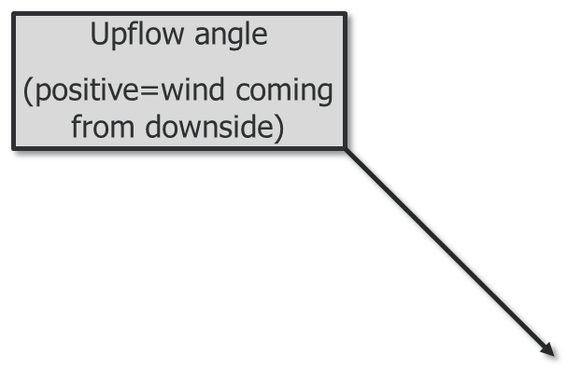
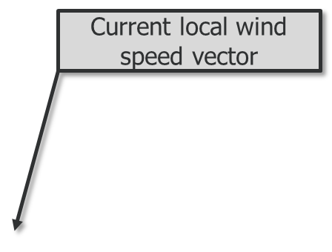
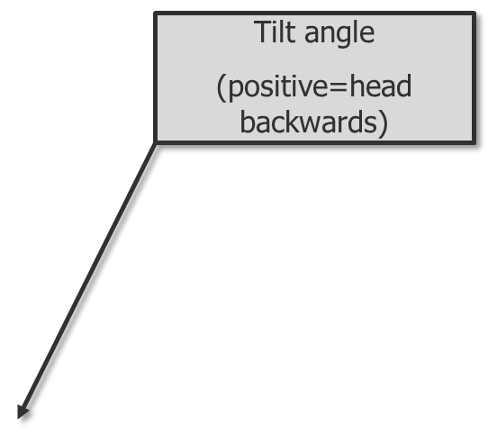
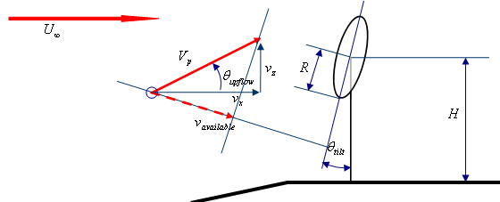
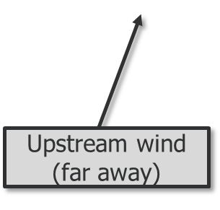
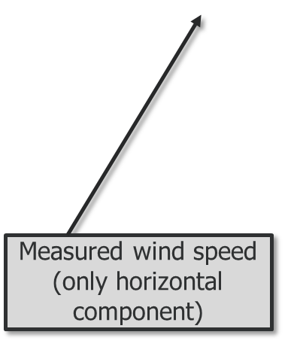
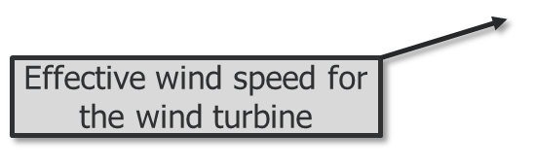
Upflow correction method
Upflow angle definition
Presentation Gamesa 2014

Slide 7
Upflow correction method
Upflow angle properties
Upflow angle is closely related to
Surrounding terrain slopes
Atmospheric stability
In a given site, the previous factors can be modeled roughly after
Wind direction Surrounding terrain slopes
Wind speed Atmospheric stability
Presentation Gamesa 2014

Slide 8
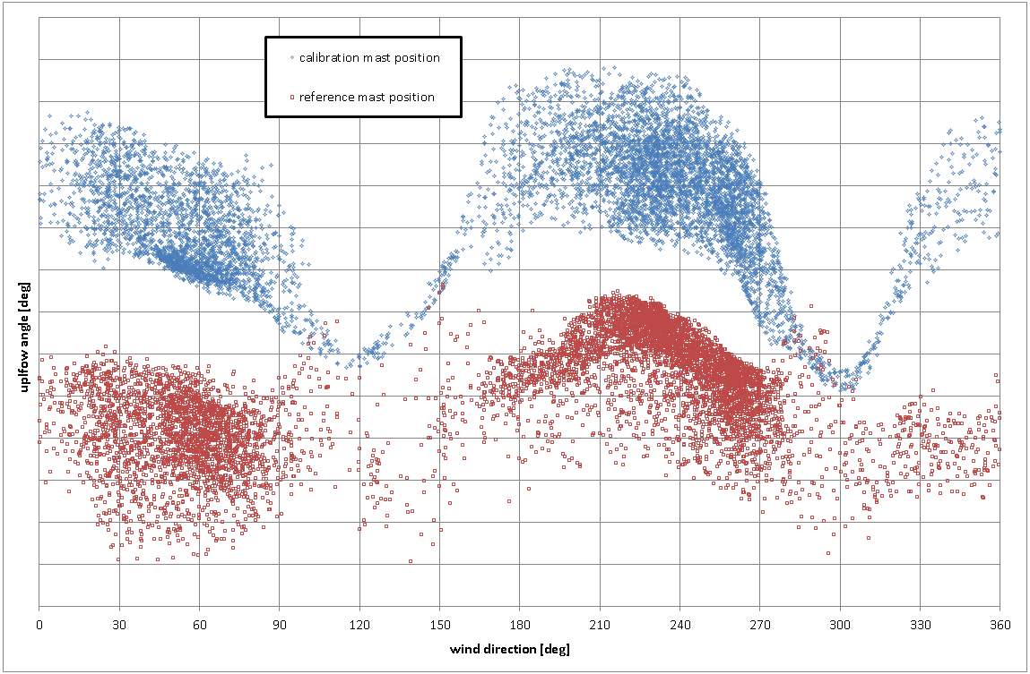
Upflow correction method
Upflow angle properties
Upflow angle at the reference met mast and the turbine location met mast
Result seems to be very dependent of wind direction and location
Presentation Gamesa 2014

Slide 9
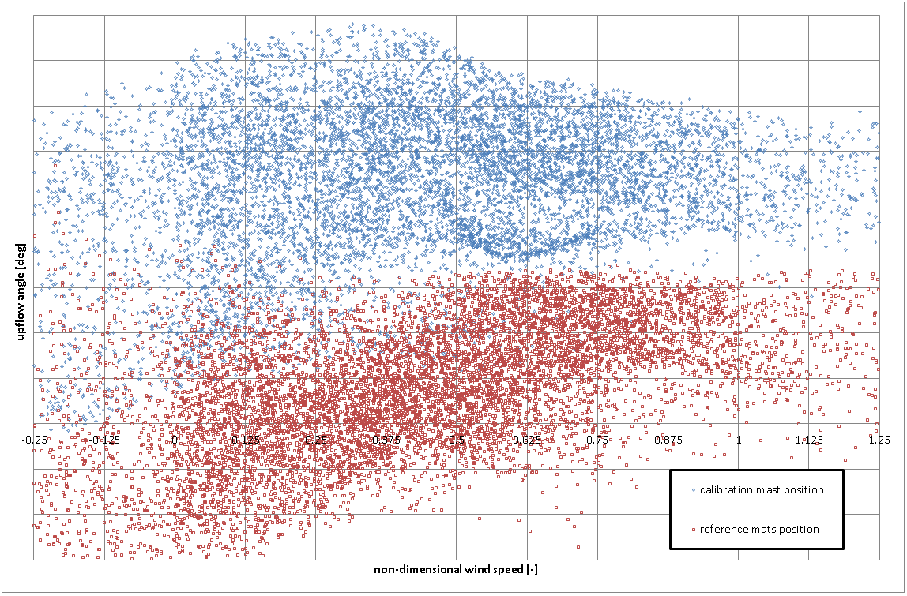
Upflow correction method
Upflow angle properties
Upflow angle at the reference met mast and the turbine location met mast
Result seems to be somehow dependent of wind speed, but this may be a proxy of atmospheric stability and difficulty to establish the angle at low in speeds (worse angle precision)
Presentation Gamesa 2014

Slide 10
Wind speed correction
Presentation Gamesa 2014

Slide 11

Upflow correction method
Wind speed correction with upflow
Use this wind speed (perpendicular to rotor) to create the power curve
This correction can be applied:
  To a catalogue curve with a reference zero upflow angle for resource assessment
  To each 10min data set in a power performance test if upflow is measured / estimated at the turbine position
  To different wind speeds and upflow angles measured at different heights to calculate REWS perpendicular to the rotor surface (energy available for the machine)
Presentation Gamesa 2014

Slide 12
Upflow correction method
Wind speed correction with upflow (using REWS)
The proposed correction method for the REWS (and included in the consensus / round robin spreadsheet) is just adding the projected wind speed to each “slice” of the rotor where wind speed is measured. The following equation summarizes the most general form of the REWS:
Sub-index “i” is the measured wind speed at height i-th
Sub-index “10min” denotes each 10min data set
The formula includes correction to the perpendicular direction to the rotor surface by wind direction gradient with height (wind veer) and the upflow angle along the variation of horizontal wind speed with height (wind shear). Each slice is weighted by the surface of the rotor covered height-wise and the cube of the speed for an equivalent energy wind speed
Presentation Gamesa 2014

Slide 13
Results
Presentation Gamesa 2014

Slide 14
Upflow correction method
Correction results (compared to measurements)
When trying to assess the results of the correction through measurements there are some challenging points to consider:
Complex sites are the ones being most “benefited” by the correction, since they are the ones with prominent upflow angles that create large corrections
Upflow angle at the turbine position is needed for the formula “to work”, so in complex sites, a calibration of that wind input parameter is also needed. Proper mast installations for such calibrations are seldom carried out
Only cup anemometry is allowed in complex terrain
Cup anemometers tend to measure the horizontal wind speed “badly” in presence of upflow angles (difference to cosine response, and behavior dependent of brand / model) and creating a new dependency of the power curve to the upflow angle that has nothing to do with performance
Presentation Gamesa 2014

Slide 15
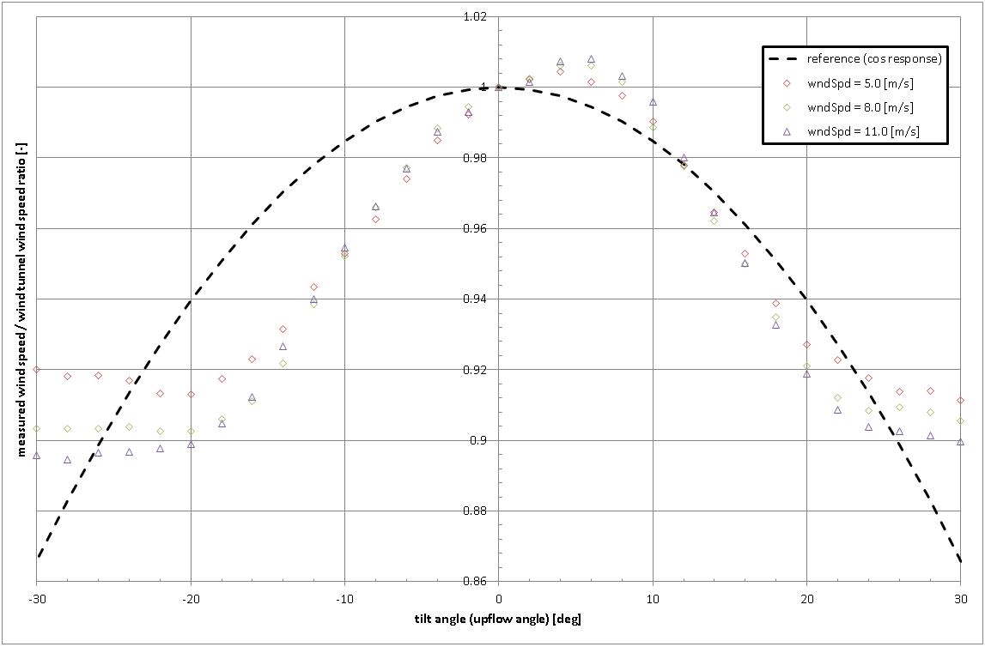
Upflow correction method
Correction results (compared to measurements)
Cup anemometer horizontal measurement response in inclined wind flow
Average complex site region: a dependency of the measured horizontal wind speed with upflow angle is created
Presentation Gamesa 2014

Slide 16
Upflow correction method
Correction results (compared to measurements)
To validate the correction with measurements, a campaign with the following requisites was used:
Site calibration with met masts installed to calibrate shear, veer and upflow
  Upflow in turbine position is estimated as upflow measured at the reference mast plus an offset per wind direction bin
Cup anemometers installed in all met masts with good response to tilted flow
Three sets of post processing:
  No additional post processing (standard power curve)
  Turbulence renormalization
  Turbulence renormalization + upflow correction
Presentation Gamesa 2014

Slide 17
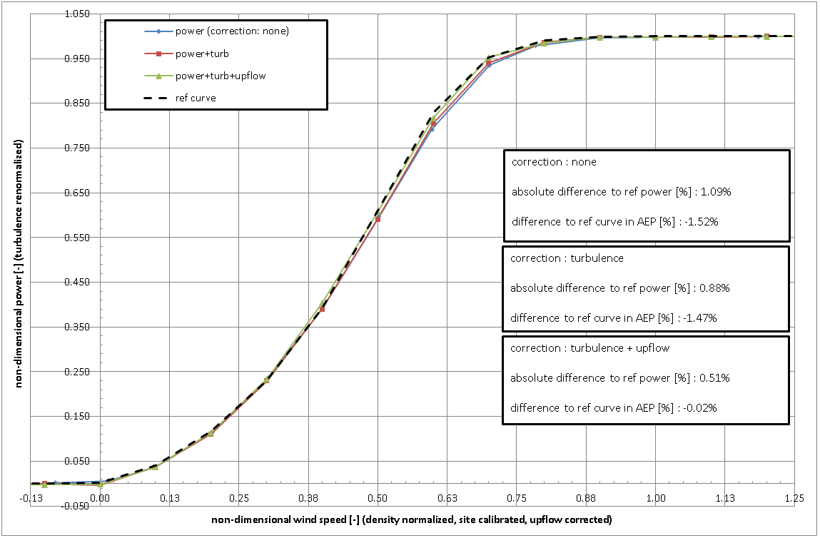
Upflow correction method
Correction results (compared to measurements)
With each additional correction the gap to the reference power curve is shortened (in [kW] and in [AEP%])
Presentation Gamesa 2014

Slide 18
Upflow correction method
Correction results (compared to BEM simulations)
The easiest way to test if the correction works is running some BEM simulations.
Very different upflow angles can be tested without measurement error
Results would be aligned with other simulation technics and could validate its use for resource assessment
The following figure shows power curves measurement created through BEM simulated 10min datasets.
Different upflow angles (but constant for each power curve simulation)
Power curve results with and without wind speed correction for upflow
Standard conditions for the rest of the relevant wind input parameters
Presentation Gamesa 2014

Slide 19
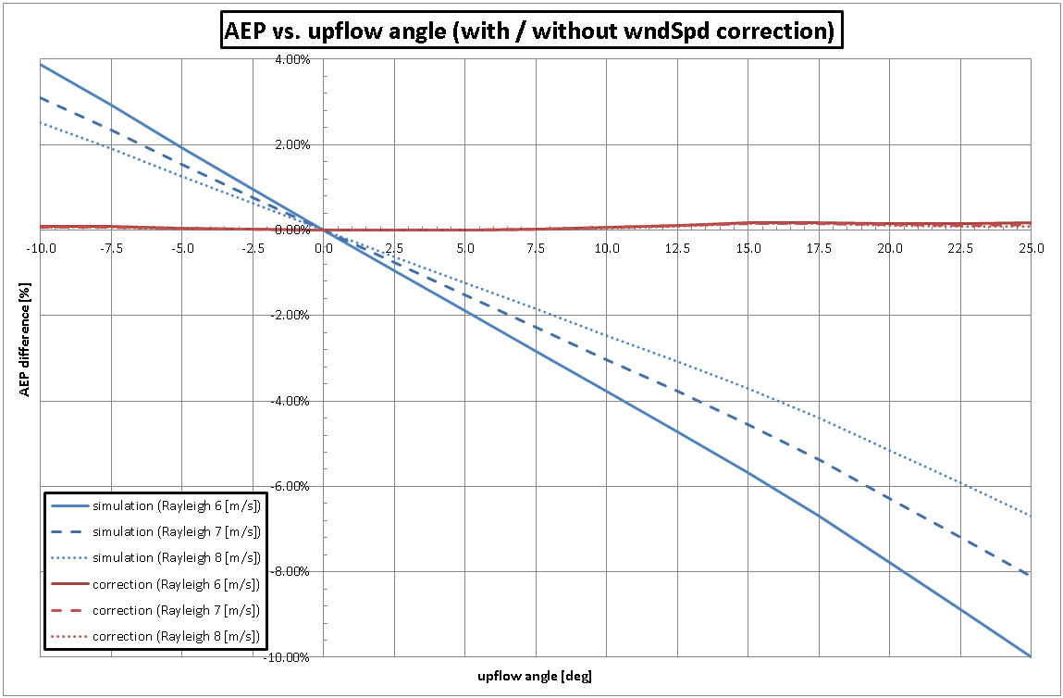
Upflow correction method
Correction results (compared to BEM simulations)
Region where cup anemometers can operate
Very complex site region
Average complex site region
AEP result is highly dependent of upflow angle and Rayleigh wind speed before correction, but almost independent after correction
Presentation Gamesa 2014

Slide 20
Conclusions
Presentation Gamesa 2014

Slide 21
Upflow correction method
Conclusions
Upflow angle is a key driver in power performance for complex and very complex terrain
In flat terrain, wind shear and veer are more important than upflow angle for the machine’s performance
The geometric upflow correction seems to work to predict power performance
Results of BEM simulations
Little empirical evidence
Presentation Gamesa 2014

Slide 22
Upflow correction method
Conclusions
The process for the correction in flat terrain and using REWS is just projecting the wind speed vector to the perpendicular direction to the rotor plane and use the REWS expression as usual
The process for the correction in complex terrain won’t use REWS usually (as RSDs are not as accurate as desired in these sites and equipping the met masts with an array of wind sensors can be very expensive). Instead, the perpendicular to rotor wind speed at hub height is recommended
In complex sites, for a proper correction factor, upflow angle must be calibrated along the wind speed in order to estimate the upflow angle at the turbine position during the power performance test
Presentation Gamesa 2014

Slide 23

Thank you
Presentation Gamesa 2014

Slide 24
Q & A
Presentation Gamesa 2014

